Slide 1
Performance Comparison of Deep Neural Ensembles On Chest X-ray Images for Pneumonia Detection
Presented By : Sai Srinath Alla
UNM ID : (101910789)

Slide 2
Contents
Introduction and Motivation
Background
Flow chart
Unbalanced Dataset
Data augmentation
Results
Remarks

Slide 3
Introduction and Motivation
•The main idea of this project is to build the deep neural ensemble model and verify that the ensemble performs better on testing data than the original models.
•The primary motivation for this project is from my experience in machine learning ensemble techniques.
•In this study, I evaluate pre-trained CNN (Feature Extractor) performance and construct an optimal ensemble towards the Pneumonia detection.
•In this project, I used majority based ensemble technique on the following models
VGG16(138,357,544 Parameters)
Inceptionv3 (23,851,784 Parameters)
InceptionResNetV2 (55,873,736 Parameters)

Slide 4
Background
In the Initial stage of the project, I found that many people are performing most of the deep learning models on the same dataset. However, they are not using the Ensemble of the most potent tool in machine learning that helps in giving better accuracy than the original model. Ensemble techniques are simple and do not require retraining of all the models. This feature of the Ensemble techniques is one of its fundamental reason for its success.

Slide 5
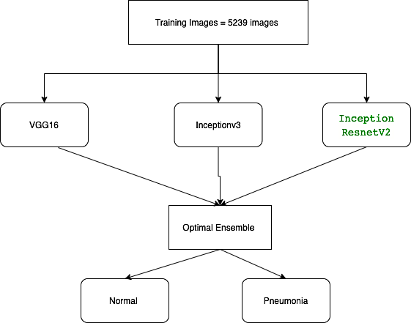
Flow Chart

Slide 6
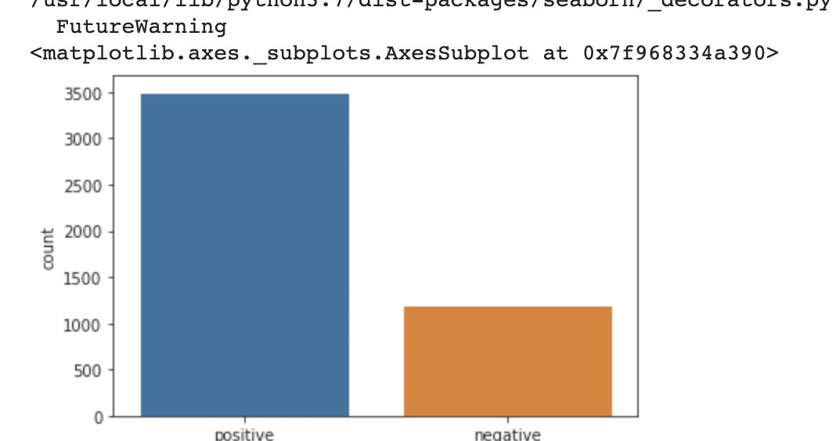
Unbalanced dataset
Two Categories of images (Normal/Pneumonia).
For Training Normal class has 1341 images and Pneumonia class has 3875 images.
I used train_test split on training set to create a validation set(10%)
For Testing(10% split) Normal class has 234 images and Pneumonia class has 390 images.

Slide 7
Data augmentation
To help the model to learn different type of images data augmentation is done on the data before given as input for training.
On the training set I implemented following transformations
rescale = 1/255,
rotation_range = 30,
zoom_range = 0.2,
width_shift_range = 0.1,
height_shift_range = 0.1)
On Test and validation set i used only rescale=1/255

Slide 8
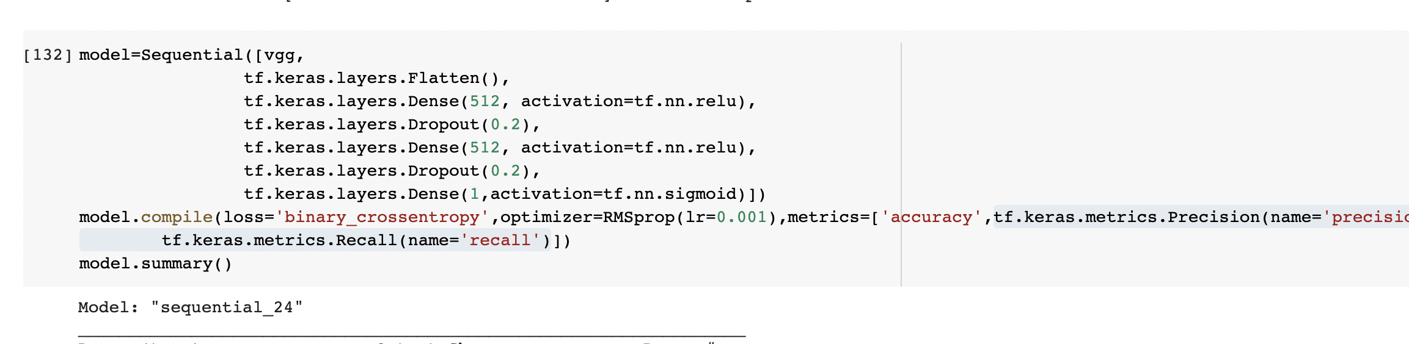
Model1:VGG16 (Feature extractor)
In this model VGG16 is used as feature extractor followed by flatten, dense and dropout layers

Slide 9
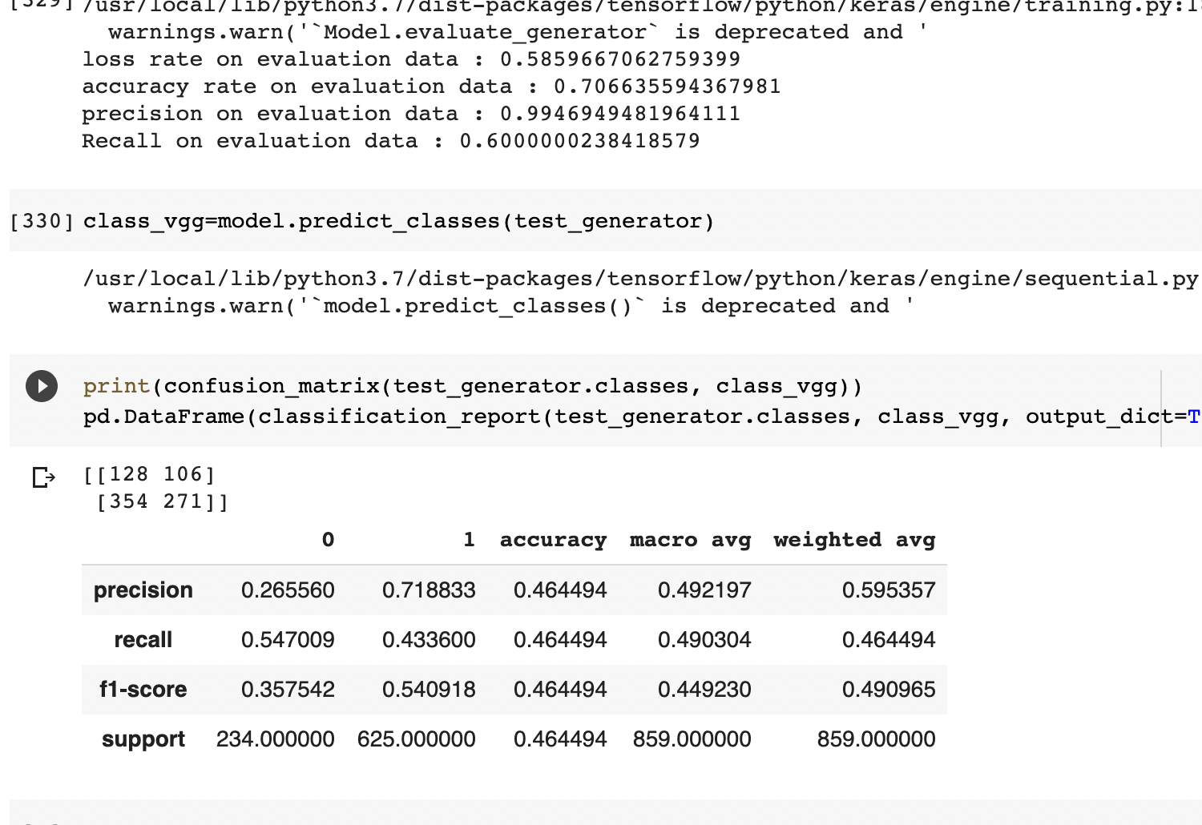
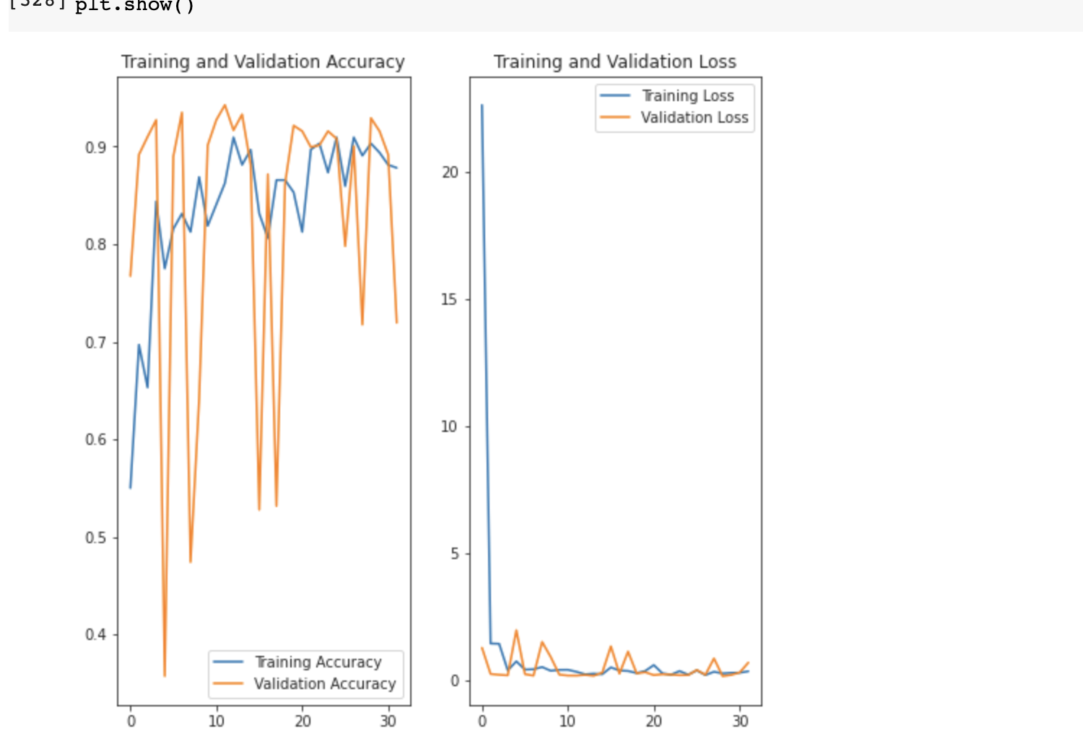
Result from model1

Slide 10
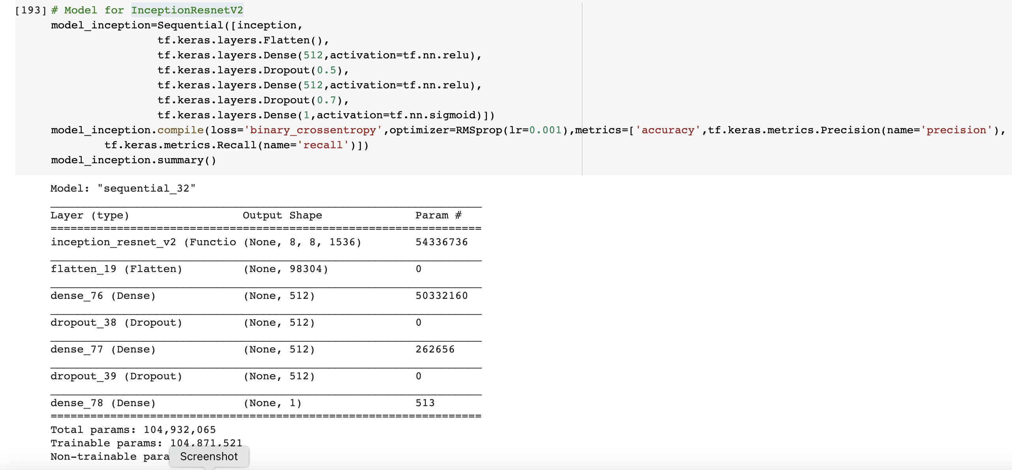
Model 2:InceptionResnetV2(Feature extractor)

Slide 11
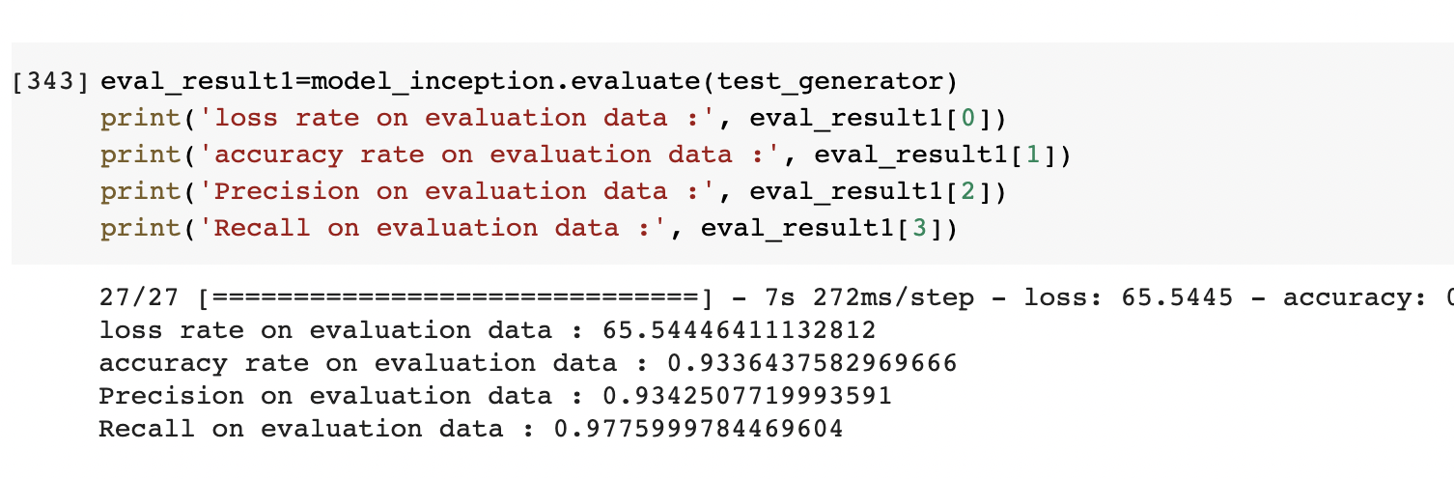
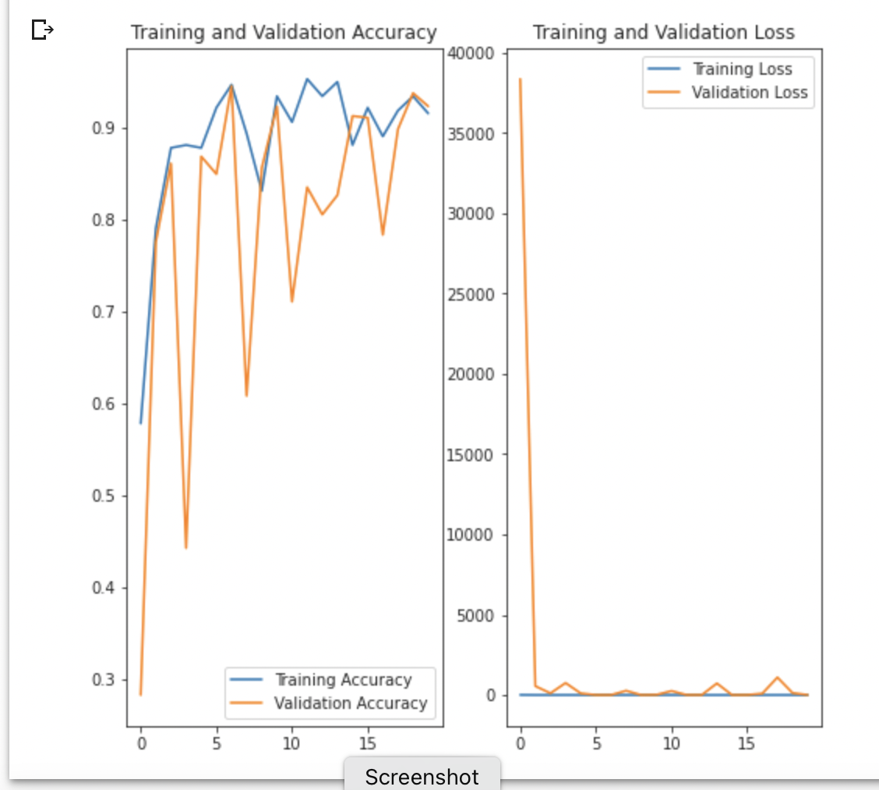
Result for model 2

Slide 12
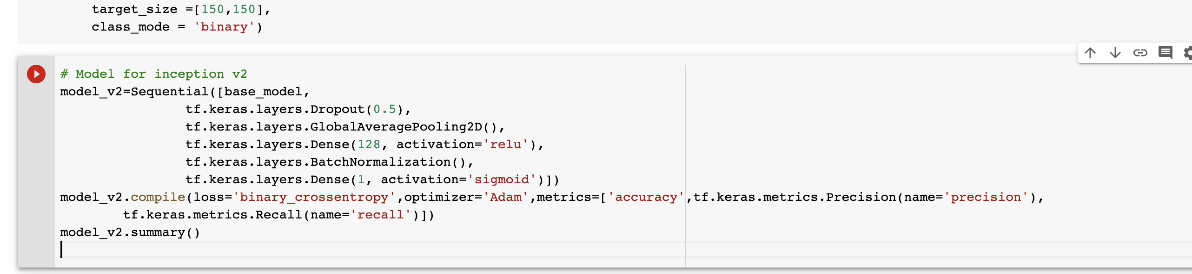
Model3: Inceptionv3 as Feature extractor
For this model I used different input size = [150,150,3]
Different metrics like accuracy, precision and recall were used to understand the learning capabilities of the model

Slide 13
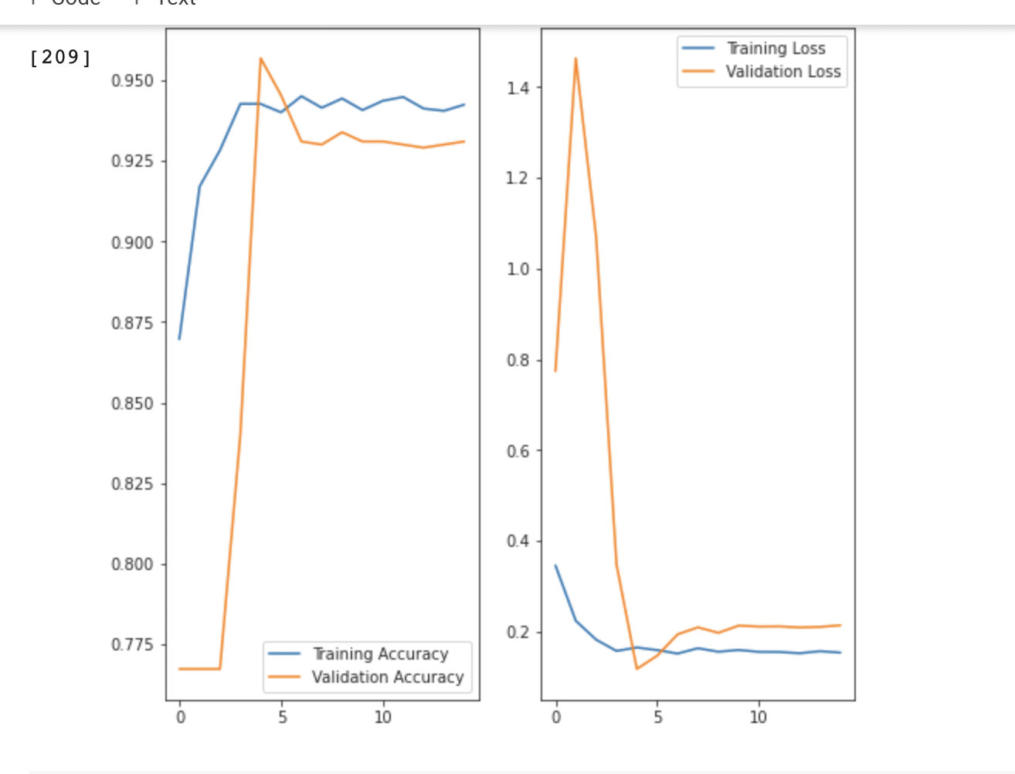
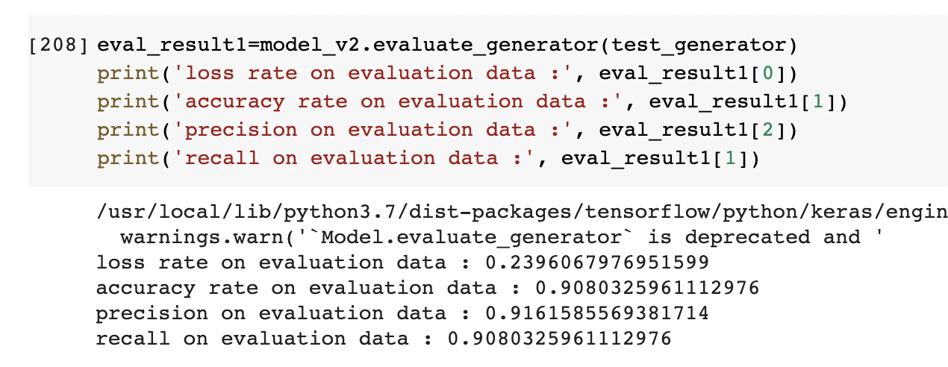
Results from model 3

Slide 14
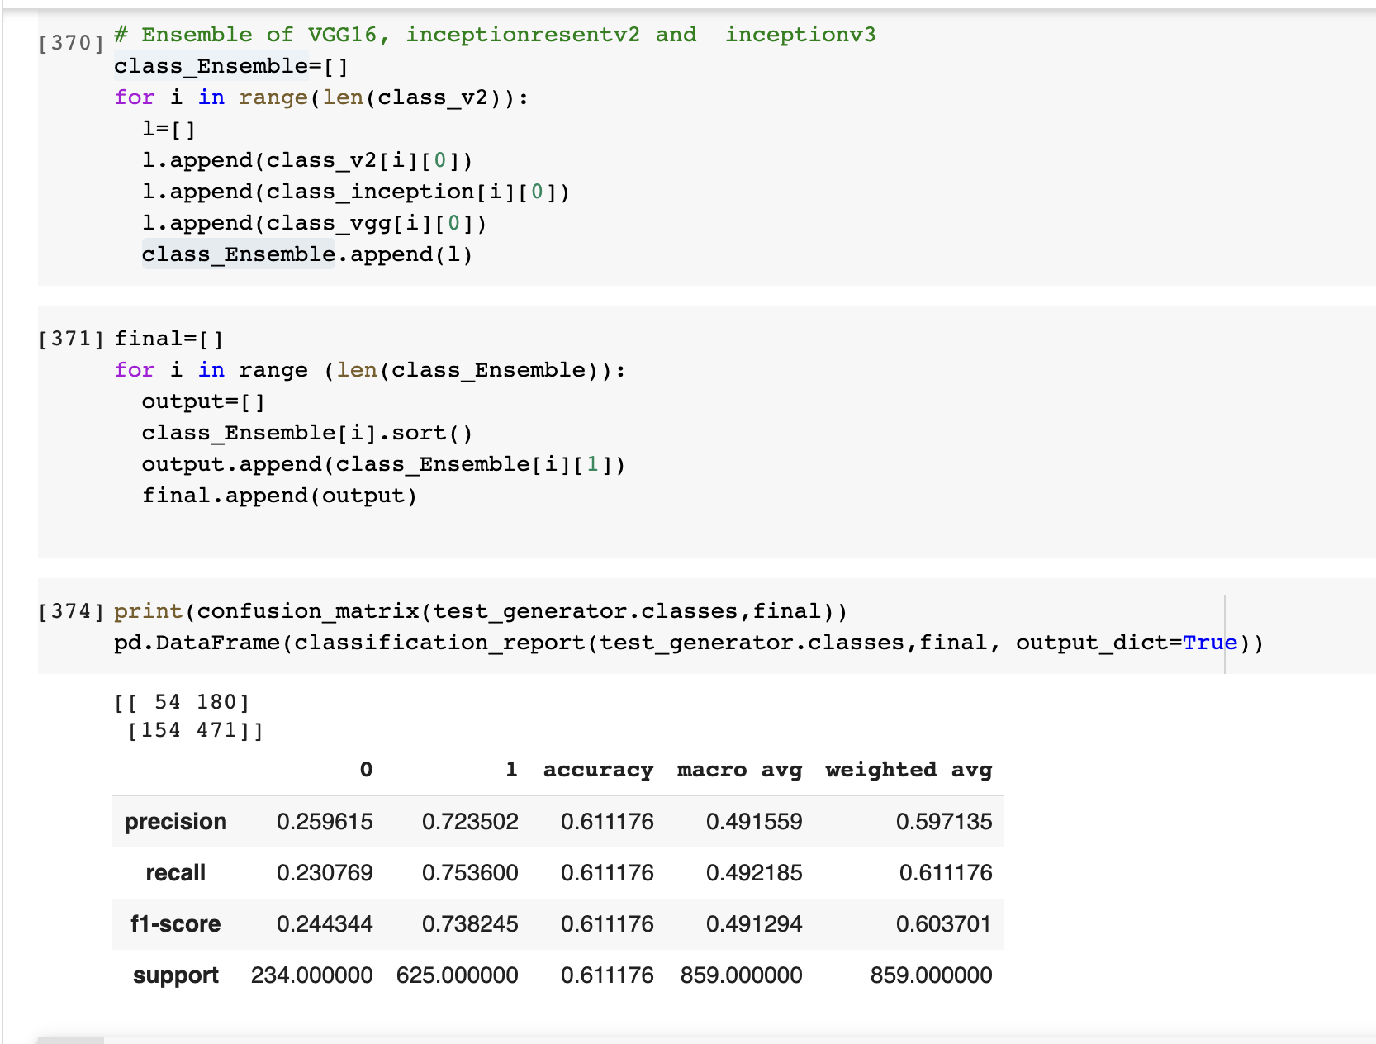
Results from Ensemble(Voting)

Slide 15
Results
In this Ensemble model the output is the majority of all the outputs from all the models based on different feature extractors.
As we all know that the main aim of the project is to create an ensemble model so show that there is certain amount of improvement in accuracy in classification compared to the initial models.
As seen in the above pictures there is a small amount of improvement in the ensemble model compared to the other models and this can be clearly seen comparing the confusion matrix of different models on the test set

Slide 16
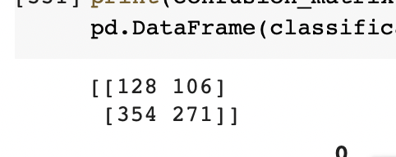
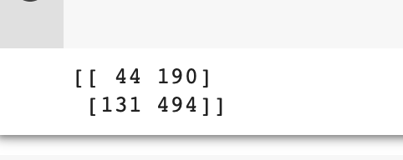
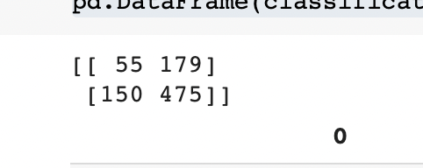
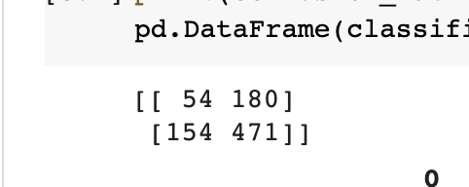
Confusion Matrix
For model1 (VGG16)
For model 3(Inceptionv2)
For model2 (Inceptionresnetv3)
For Ensemble model

Slide 17
Remarks and future scope
• This project is like a hands-on experience for the image processing class. I gained a lot from this project, like applying neural networks and the concept behind various hyperparameters that control and improve the neural network.
• As we have seen, the Ensemble worked better than the some of the original model in this case like VGG16,Inceptionv2,and also, because of the weakness in one of the models, the entire Ensemble is compromised.
The main drawback is that building multiple models with good performance is time consuming and computationally expensive.
This technique is very much helpful when we have the computational power to build multiple models then this will definitely improve the accuracy than the original model.

Slide 18
Thank you

